Slide 1

Social Determinants of Health and
Covid-19 Infection and Death Rates
Temitope Oshinowo
SML 310 - Final Project

Slide 2

Outline
1.0 | 2.0 | 3.0 | 4.0 | 5.0
Introduction | Relevant Data | EDA | Modeling | Results
6.0
Conclusion

Slide 3
Introduction
1
Covid-19 Context
2
Social Determinants of Health
3
Related Work
4
Main Research Question

Slide 4


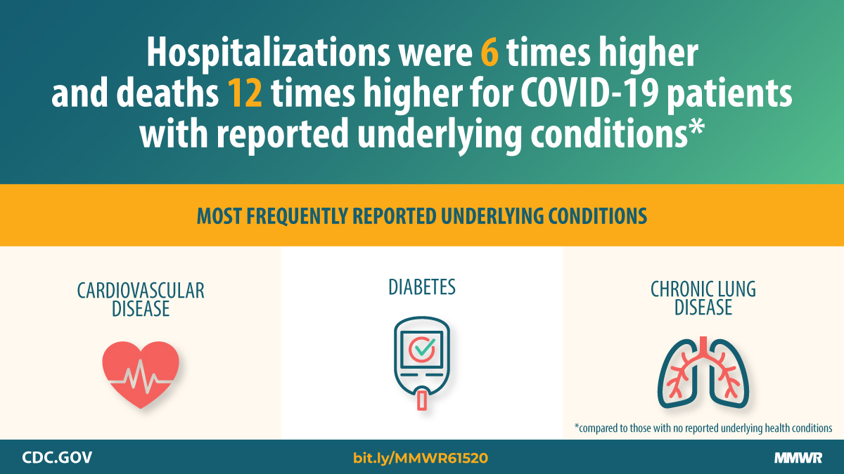
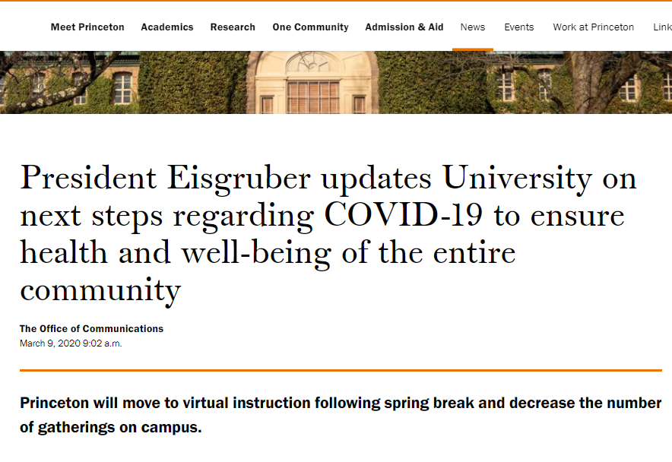

Introduction - Covid-19 Context
WSJ, KEM Law, Zoom, Princeton, CDC (2020)
Notes:
WSJ Source: https://www.wsj.com/articles/the-failed-experiment-of-covid-lockdowns-11599000890
KEM Law: https://www.kemlaw.com/2020/07/14/covid-19-and-multi-state-businesses-how-to-manage-varying-closure-rules-and-infection-rates/
Princeton: https://www.princeton.edu/news/2020/03/09/president-eisgruber-updates-university-next-steps-regarding-covid-19-ensure-health
Zoom: https://www.eweek.com/enterprise-apps/zoom-unveils-slew-of-new-features-at-zoomtopia-2020
CDC Source: https://www.cdc.gov/mmwr/volumes/69/wr/mm6924e2.htm

Slide 5
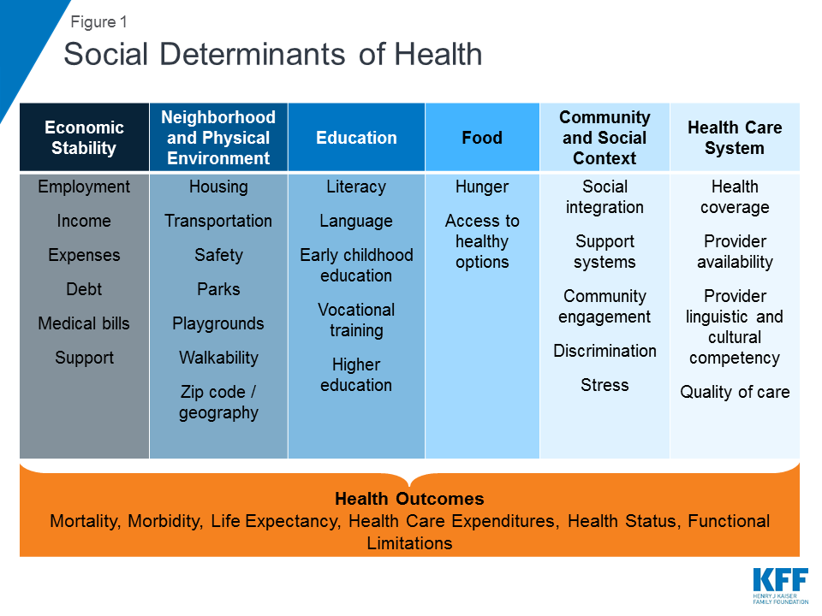
Introduction - Social Determinants of Health
Social determinants of health:
The economic and social conditions which affect a person’s living environment and health status.
Often the result of human interference or achievement
Examples: Residential Environment, Occupation, Education, and Income Levels
Kaiser Family Foundation (2018)
Notes:
Source: https://www.kff.org/racial-equity-and-health-policy/issue-brief/beyond-health-care-the-role-of-social-determinants-in-promoting-health-and-health-equity/

Slide 6
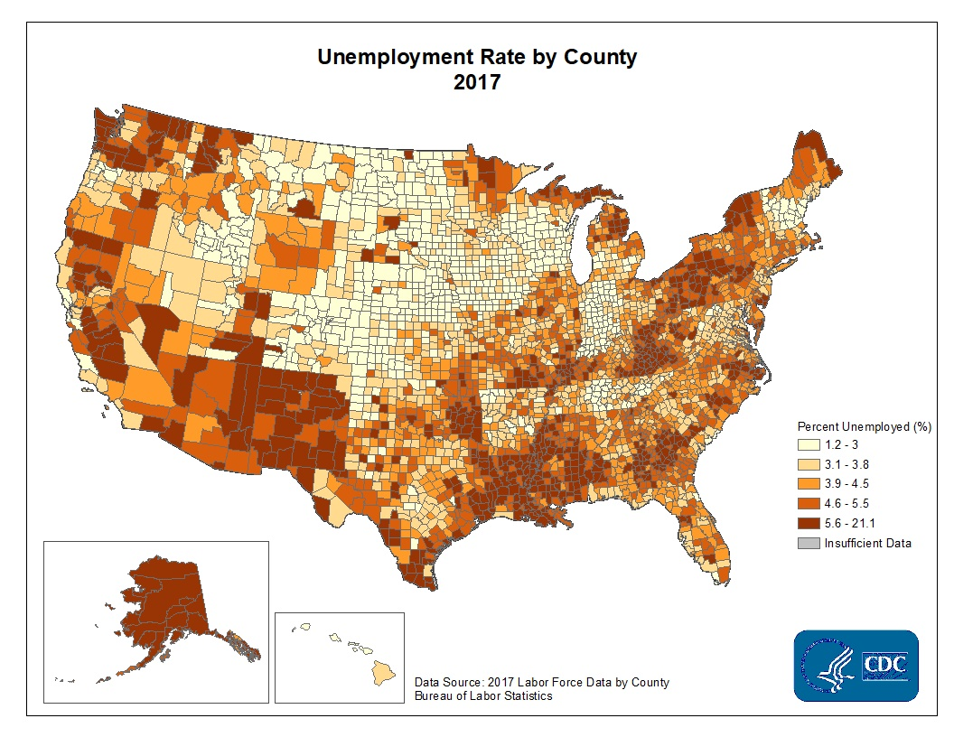
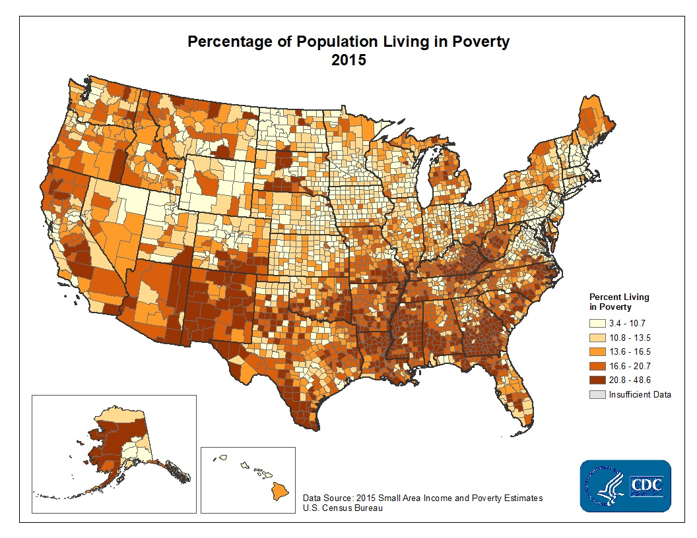
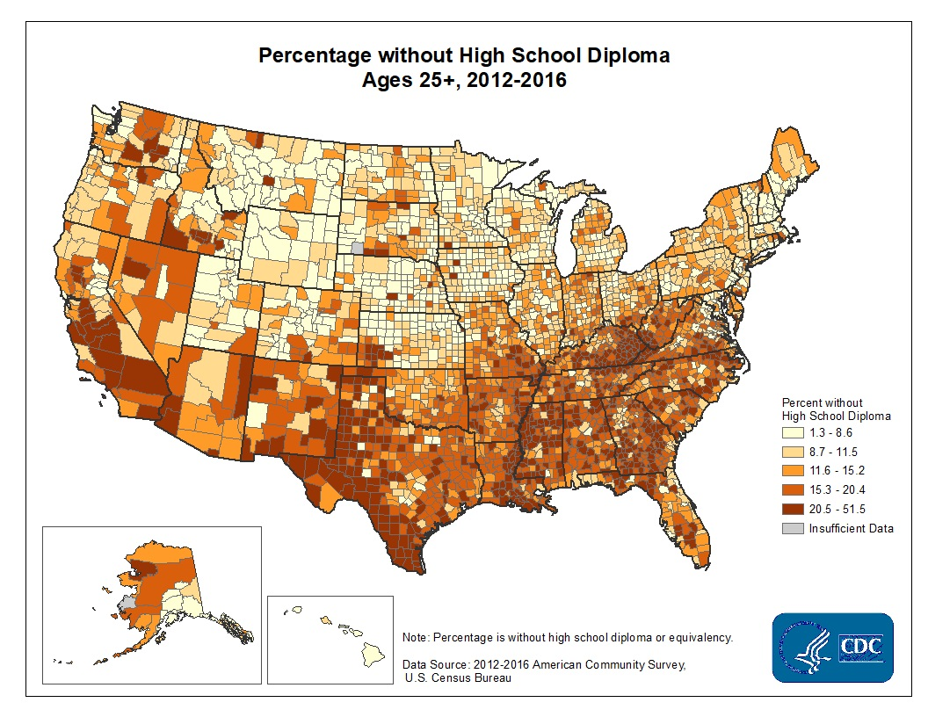
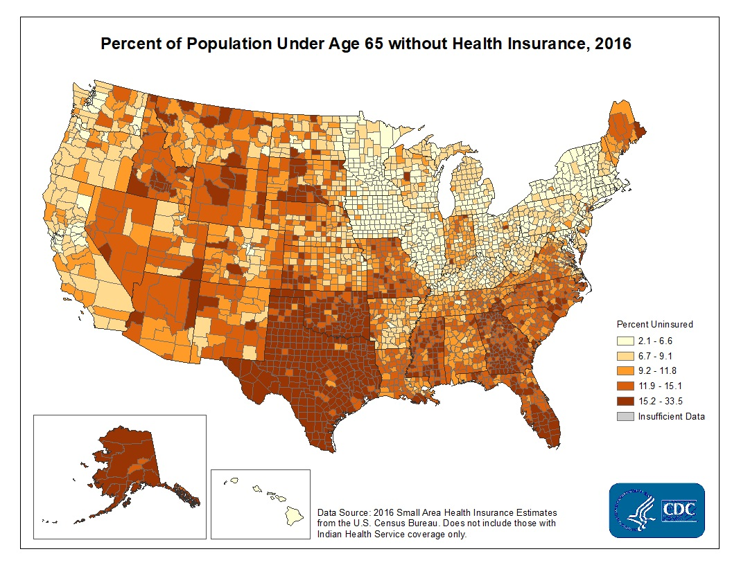
Introduction - Related Work
CDC Social Determinants of Health:
We can already start to see certain patterns
But how do these trends interact with the Covid-19 pandemic?
Notes:
Source: https://www.cdc.gov/dhdsp/maps/sd_insurance.htm
Source: https://www.cdc.gov/dhdsp/maps/sd_high_school.htm
Source: https://www.cdc.gov/dhdsp/maps/sd_unemployment.htm
Source: https://www.cdc.gov/dhdsp/maps/sd_poverty.htm

Slide 7
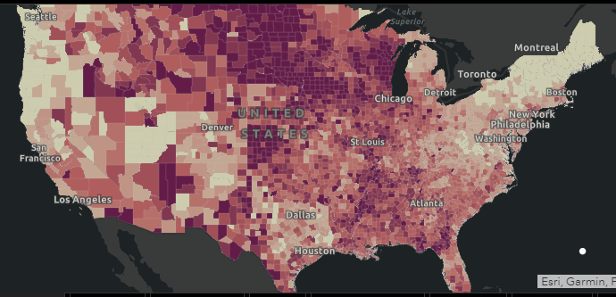
Introduction - Related Work
Johns Hopkins University’s (JHU) COVID-19 Dashboard
Updated once a day (this is from 11/30)
Total Cases Per County
I will graph per 1,000 by county
I will also graph deaths per 1,000
Is this influenced by any social determinants?

Slide 8
Introduction - Main Research Question
What, if any, are the socially deterministic drivers of Covid prevalence and mortality?
How do these drivers affect Covid infection and death rates?

Slide 9
Outline
1.0 | 2.0 | 3.0 | 4.0 | 5.0
Introduction | Relevant Data | EDA | Modeling | Results
6.0
Conclusion

Slide 10
Relevant Data
1
Datasets Obtained
2
Cleaning the Sheets
3
Test-Train Split

Slide 11
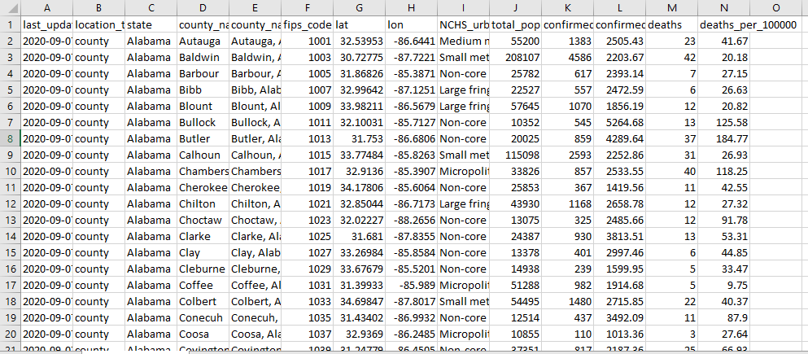
Relevant Data - Johns Hopkins Covid Case Tracker
JHU Coronavirus Case Tracker (2020)
Notes:
Source: https://data.world/associatedpress/johns-hopkins-coronavirus-case-tracker

Slide 12
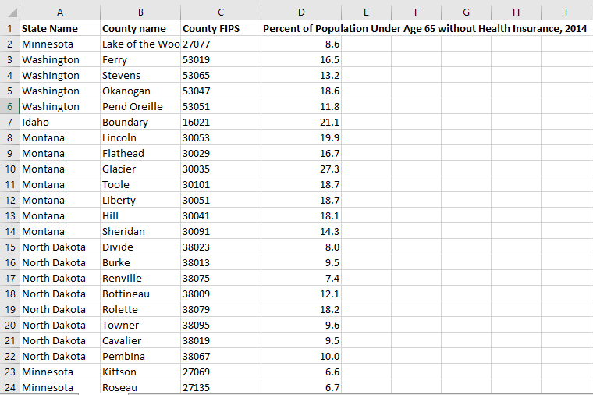
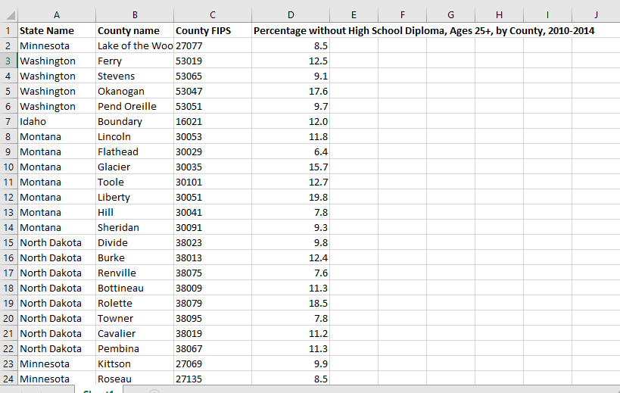
Relevant Data - CDC Social Determinants of Health
CDC Social Determinants of Health (2015-2018)
Notes:
Source: https://www.cdc.gov/dhdsp/maps/sd_insurance.htm
Source: https://www.cdc.gov/dhdsp/maps/sd_high_school.htm
Source: https://www.cdc.gov/dhdsp/maps/sd_unemployment.htm
Source: https://www.cdc.gov/dhdsp/maps/sd_poverty.htm

Slide 13
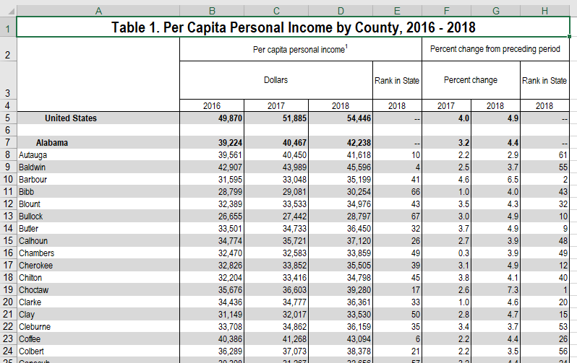
Relevant Data - Per-Capita Income Per County
Bureau of Economic Analysis (2018)
Notes:
Source: https://www.bea.gov/data/income-saving/personal-income-county-metro-and-other-areas

Slide 14
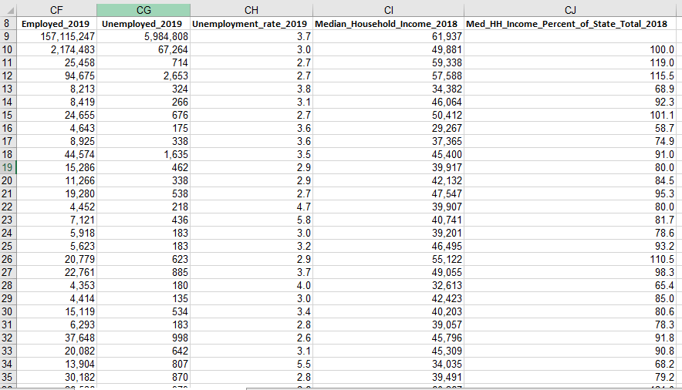
Relevant Data - Median Household Income Per County
United States Department of Agriculture Economic Research Service (2018)
Notes:
Source: https://data.ers.usda.gov/reports.aspx?ID=17828

Slide 15
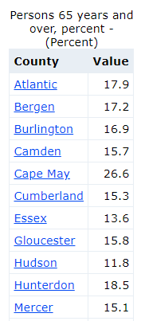
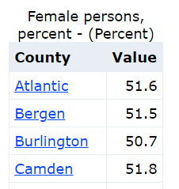
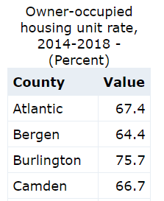
Relevant Data - % Over 65, % Female, % Homeowners
U.S. Census Bureau, Population Estimates Program (2018)
Notes:
Source: https://www.indexmundi.com/facts/united-states/quick-facts/all-states/percent-of-population-65-and-over#table
Source: https://www.indexmundi.com/facts/united-states/quick-facts/all-states/homeownership-rate
Source: https://www.indexmundi.com/facts/united-states/quick-facts/all-states/female-population-percentage#table

Slide 16
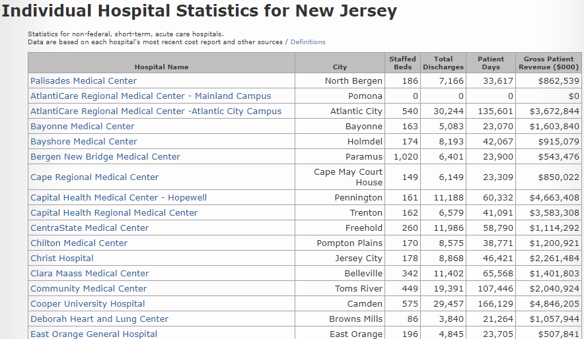
Relevant Data - Hospital Beds Per State
American Hospital Association (2018)
Notes:
Source: https://www.ahd.com/state_statistics.html

Slide 17
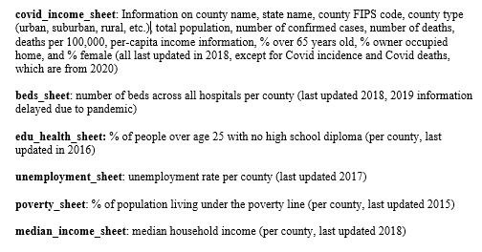
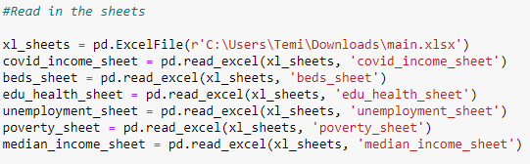
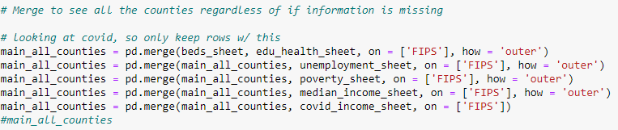
Relevant Data - Putting it all Together

Slide 18
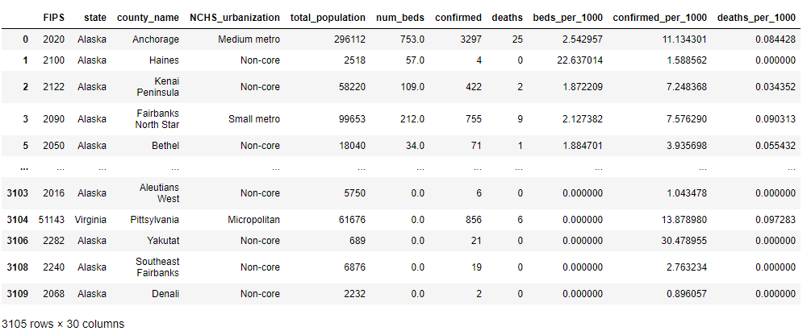
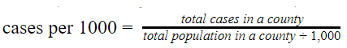
Relevant Data - Putting it all Together
Added confirmed cases, deaths, and beds per 1,000
Removed rows with NaN (3114 counties to 3105)
Added Quartiles for confirmed cases per 1000 and deaths per 1000
Renamed columns as desired

Slide 19
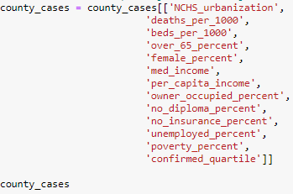
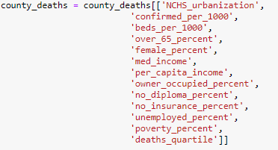
Relevant Data - Test Train Split
30% 70% Test Train Split
Training Set: 2173 counties with 12 features
Test Set: 932 counties with 12 features
Predicting Quartile for
Confirmed Cases per 1,000
Predicting Quartile for
Deaths per 1,000

Slide 20
Outline
1.0 | 2.0 | 3.0 | 4.0 | 5.0
Introduction | Relevant Data | EDA | Modeling | Results
6.0
Conclusion

Slide 21
Exploratory Data Analysis
1
Choropleth Maps
2
EDA: Confirmed Cases
3
EDA: Deaths

Slide 22
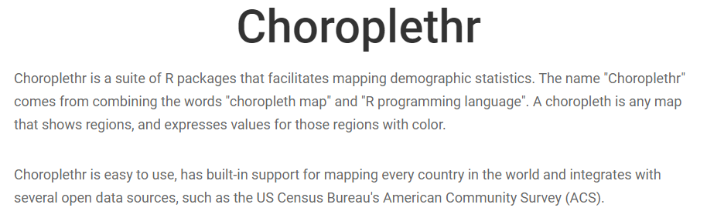
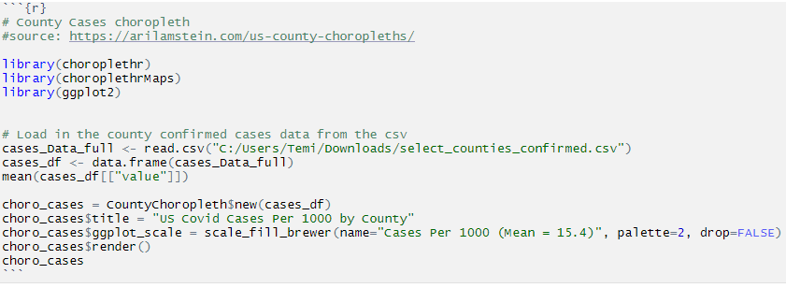
EDA: Choroplethr
Notes:
Source: https://arilamstein.com/open-source/

Slide 23
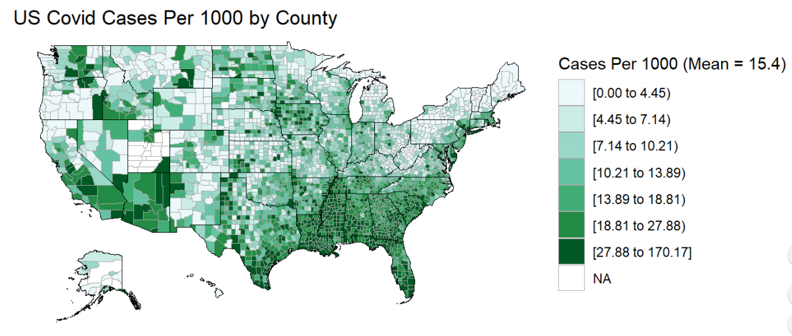
EDA: Cases per 1000 by County

Slide 24
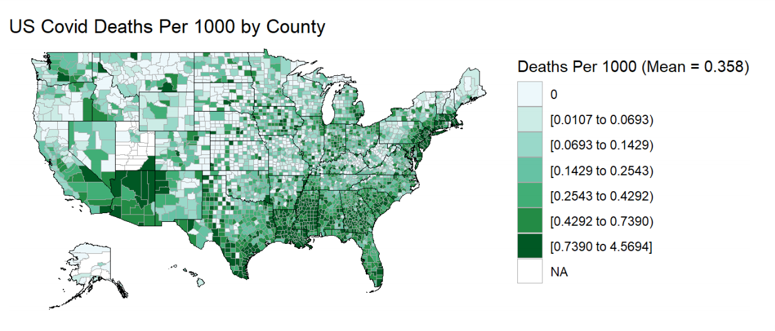
EDA: Deaths per 1000 by County

Slide 25
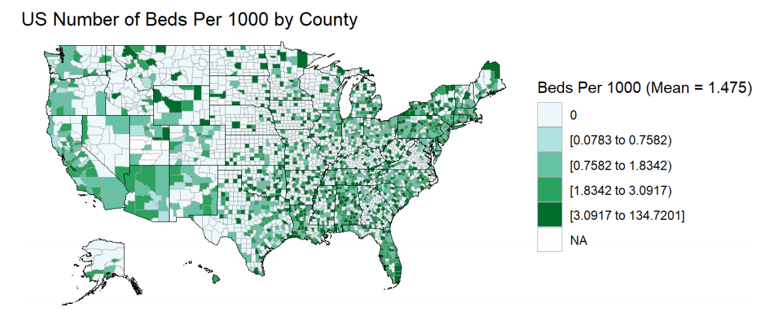
EDA: Number of Beds per 1000 by County

Slide 26
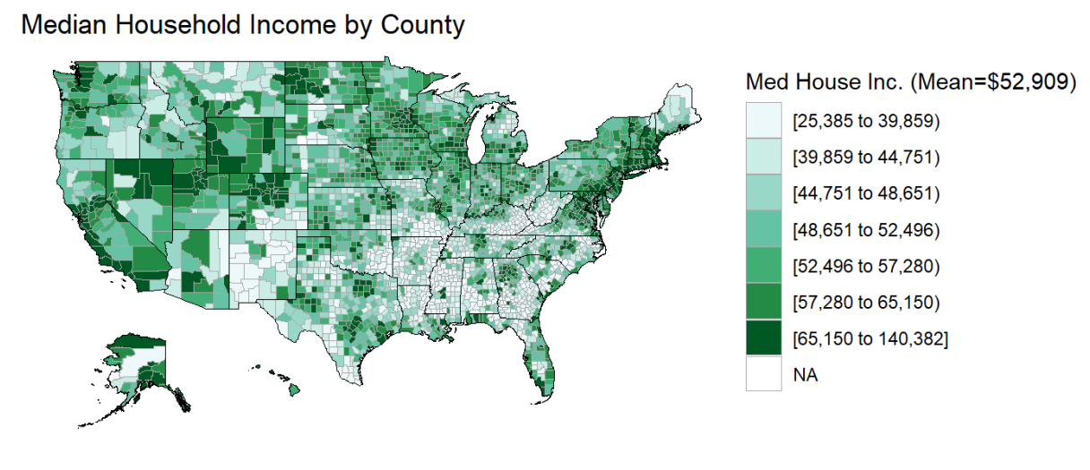
EDA: Median Household Income by County

Slide 27
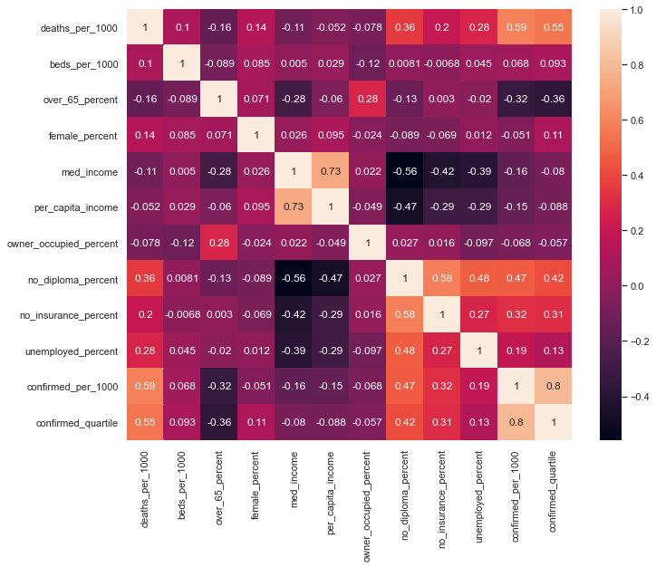
EDA: “Confirmed Cases”: Feature Relationships

Slide 28
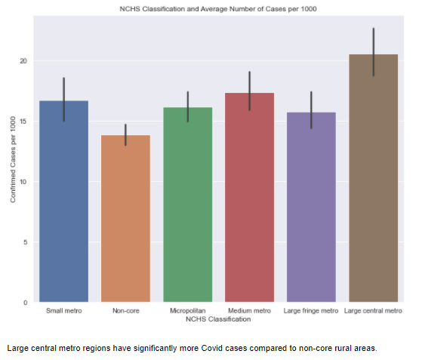
EDA: “Confirmed Cases”: Feature Relationships

Slide 29
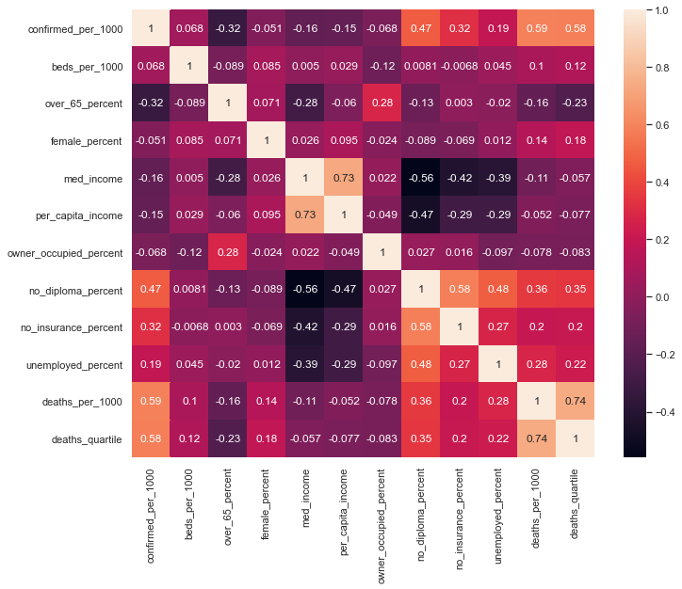
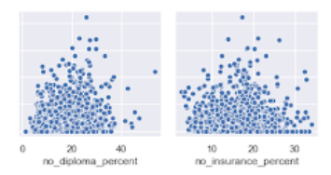
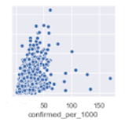
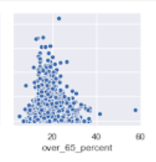
EDA: “Deaths” Feature Relationships

Slide 30
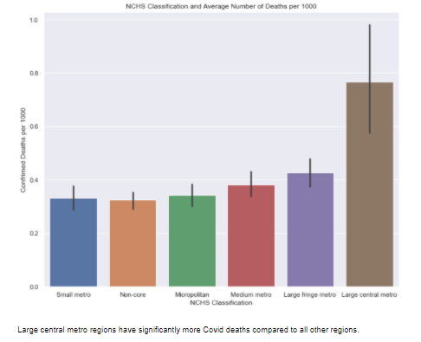
EDA: “Deaths” Feature Relationships

Slide 31
Outline
1.0 | 2.0 | 3.0 | 4.0 | 5.0
Introduction | Relevant Data | EDA | Modeling | Results
6.0
Conclusion

Slide 32
Modeling
1
Decision Tree for Cases
2
Random Forest for Cases
3
Decision Tree for Deaths
4
Random Forest for Deaths
5
Takeaway

Slide 33
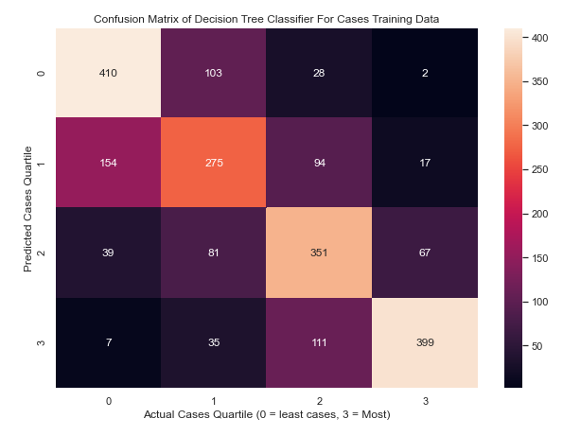
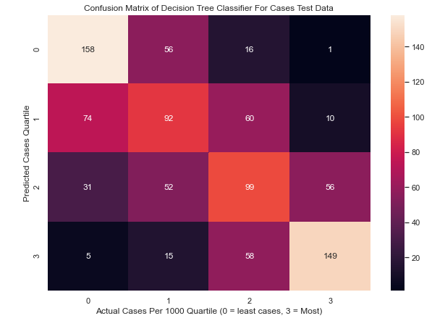
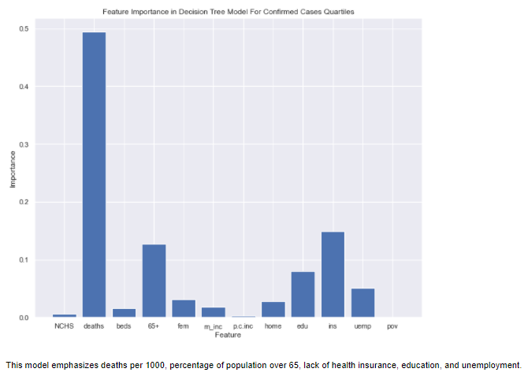
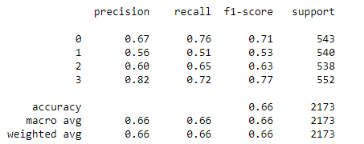
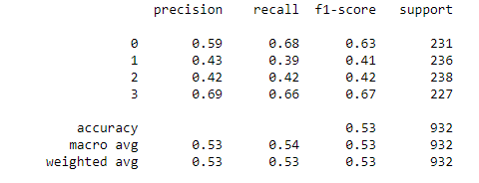
Modeling - Decision Tree Classifier
for Quartiles (Cases per 1000)
Decision Tree Classifier (max_depth = 6)

Slide 34
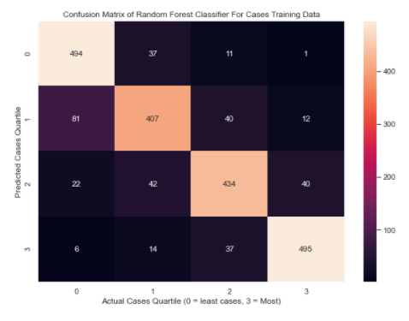
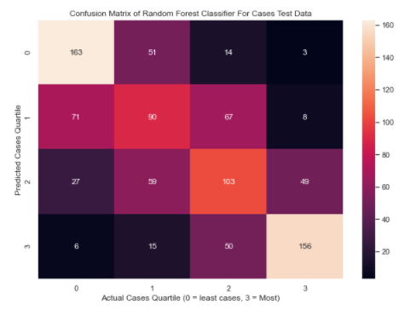
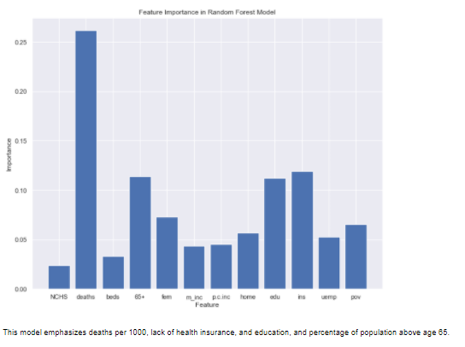
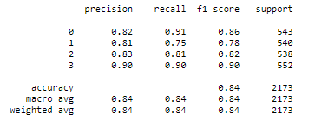
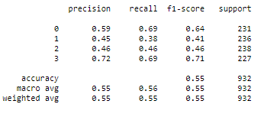
Modeling - Random Forest Classifier
for Quartiles (Cases per 1000)
Random Forest Classifier (n_estimators=20, max_depth=8, random_state=0)

Slide 35
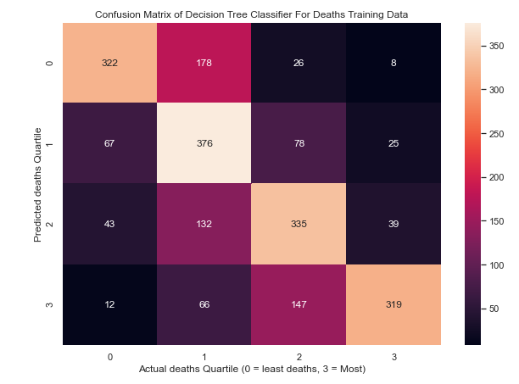
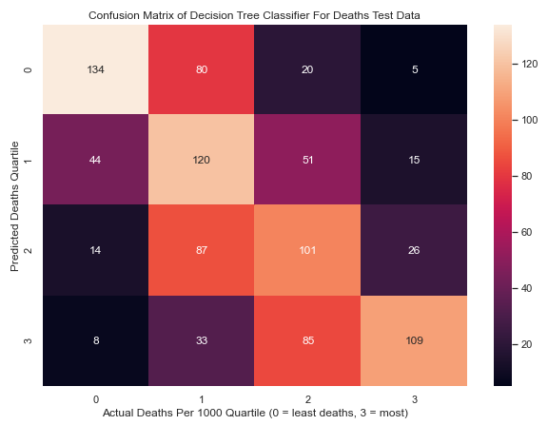
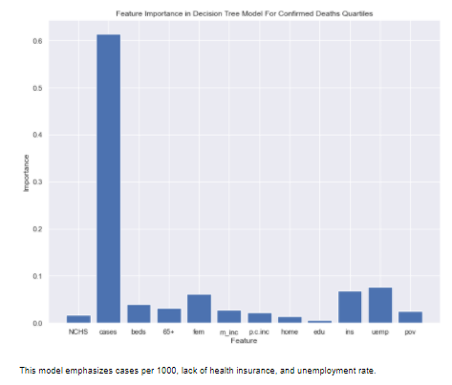


Modeling - Decision Tree Classifier
for Quartiles (Deaths per 1000)
Decision Tree Classifier (max_depth = 6)

Slide 36





Modeling - Random Forest Classifier
for Quartiles (Deaths per 1000)
Random Forest Classifier (n_estimators=20, max_depth=8, random_state=0)

Slide 37
Modeling - Takeaway
All models had better performance on the training set (in classifying countries into the appropriate quartiles) compared to the test set
In some cases, the test performance just above chance
However, F1s for the test set were relatively high when observing the top and bottom quartiles (above 60% with all models).
Analysis will consider the top and bottom quartiles when looking at Covid deaths disparities.
Random forest classifier had higher test accuracy performance
Ability to learn more by exploring many trees
Important Socially Deterministic Features:
% without a high school diploma (positively correlated with case and death rates)
% without health insurance (also positively correlated with case and death rates)

Slide 38
Outline
1.0 | 2.0 | 3.0 | 4.0 | 5.0
Introduction | Relevant Data | EDA | Modeling | Results
6.0
Conclusion

Slide 39
Results
1
Examining Quartiles
2
County Disparities

Slide 40


Results - Looking at Averages Across Quartiles,
Percent Without High School Diploma
Mean: 18.69 土 7.23
Mean: 19.79 土 6.87
Mean: 12.22 土 5.38
Mean: 12.44 土 5.65
No Significant Difference in Averages Between Top and Bottom Quartiles

Slide 41


Results - Looking at Averages Across Quartiles,
Percent Without Health Insurance
Mean: 17.17 土 4.58
Mean: 16.30 土 5.42
Mean: 12.99 土 4.60
Mean: 13.68 土 5.01
No Significant Difference in Averages Between Top and Bottom Quartiles

Slide 42


Results - Looking at Averages Across Quartiles,
Percent in Poverty
Mean: 19.65 土 6.99
Mean: 14.52 土 5.38
Mean: 14.74 土 5.25
Mean: 18.90 土 7.35
No Significant Difference in Averages Between Top and Bottom Quartiles

Slide 43
Results - Looking at Averages Across Quartiles
Much of of the population is affected by the pandemic to similar degrees
Demonstrated by overlapping error bars even between the top and bottom quartiles
Explains why model had trouble classifying counties in the middle 2 quartiles
The pandemic has widespread effects
Targets various locations with different qualities, as represented by the large range in dots within an individual outcome bucket (quartile).
Next: Explore how Outliers drive differences
The disparities we are seeing (differences between the top and bottom quartile) are not due to most of the data as a whole, so are they due to outliers?
Examine the top 150 (top 5%) and bottom 150 counties (bottom 5%) across some social deterministic features and observe the differences in confirmed cases and deaths across these 2 groups.

Slide 44




Results - Social Determinant Disparities and Effect on Confirmed Cases and Deaths

Slide 45


Results - Disparities in Percent Without High School Diploma and Effect on Confirmed Cases and Deaths
Hancock, GA: 27.5% of people do not have a high school diploma in The death rate per 1000 is 4.5 and the case rate is 43.3
Mean: 30.01土 20.39
Mean: 0.74 土 0.77
Mean: 0.15 土 0.24
Mean: 9.31 土 6.68
No Significant Difference in Cases & Deaths between Top and Bottom 5%

Slide 46


Results - Disparities in Percent Without Health Insurance and Effect on Confirmed Cases and Deaths
Hancock, GA: 17.1% of people do not have health insurance. The death rate per 1000 is 4.5 and the case rate is 43.3
Mean: 0.52 土 0.55
Mean: 20.99 土 17.99
Mean: 0.30 土 0.39
Mean: 11.05 土 6.42
No Significant Difference in Cases & Deaths between Top and Bottom 5%

Slide 47


Results - Disparities in Median Household Income and Effect on Confirmed Cases and Deaths
Hancock, GA: The median household income is $31716.0. The death rate per 1000 is 4.5 and the case rate is 43.3
Mean: 0.81 土 0.92
Mean: 26.39 土 21.19
Mean: 0.45 土 0.50
Mean: 13.79 土 7.05
No Significant Difference in Cases & Deaths between Top and Bottom 5%

Slide 48
Outline
1.0 | 2.0 | 3.0 | 4.0 | 5.0
Introduction | Relevant Data | EDA | Modeling | Results
6.0
Conclusion

Slide 49
Conclusion
1
Summary of Findings
2
Next Steps

Slide 50
Conclusion - Summary of Findings
Some social deterministic features had a slight positive correlation with Covid-19 cases and deaths
These correlations did not produce significant differences when comparing the most advantaged and most disadvantaged groups
While these determinants did not illustrate significant differences in Covid outcomes across all 3000+ counties, they bring harm to already disadvantaged communities
More variability in Covid outcomes for disadvantaged groups compared to the most advantaged groups.
Hancock, GA, many negative determinants and high case and death rate
Work on education: This determinant has already displayed a slight (but not significant) relationship to Covid outcome, we must ensure that education achievement does not deteriorate due to a lack of resources to learn.

Slide 51
Conclusion - Next Steps
Effects of Second Wave
My data is from March-September 7, 2020
Work with the most recent data when it becomes available
May also add more clarity within the models
Information on hospitalization rate
How does policy affect outcomes?
Observe how demographically similar cities fare during a pandemic as a result of policy intervention (or lack thereof)

Slide 52
Conclusion
This project illustrated how several non-biological social determinants relate to Covid-19 confirmed cases and deaths.
It determined that while factors such as education and having health insurance are not strongly directly related to Covid outcomes nationwide, they may still work to harm already vulnerable populations.

Slide 53
References
“American Hospital Directory: Hospital Statistics by State.” American Hospital Directory, 29May 2020. Web. Retrieved 20 Sep 2020.
<https://www.ahd.com/state_statistics.html>.
“Certain Medical Conditions and Risk for Severe Covid-19 Illness.” CDC.gov, U.S. Department of Health & Human Services, 11 Sep 2020.
Web. Retrieved 26 Sep 2020.
<https://www.cdc.gov/coronavirus/2019-ncov/need-extra-precautions/people-with-medical-conditions.html>.
“County-level Data Sets.” Economic Research Service, United States Department of Agriculture. 13 May 2020. Web. Retrieved 26 Sep 2020.
<https://www.ers.usda.gov/data-products/county-level-data-sets/>.
“COVID-19 United States Cases by County.” JHU.edu, 26 Sep 2020. Web. Retrieved 26 Sep 2020. <https://coronavirus.jhu.edu/us-map>.
“Health Care Maps—Health Insurance” CDC.gov, U.S. Department of Health & Human Services, 14 Nov 2020. Web. Retrieved 26 Nov
2020. <https://www.cdc.gov/dhdsp/maps/sd_insurance.htm>.
“Johns Hopkins COVID-19 Case Tracker.” DataWorld.com, 7 Sep 2020. Web. Retrieved 7 Sep 2020.
<https://data.world/associatedpress/johns-hopkins-coronavirus-case-tracker>.
“Personal Income by County, Metro, and Other Areas.” Bureau of Economic Analysis, United States Department of Commerce, 14 Nov 2019.
Web. Retrieved 20 Sep 2020. <https://www.bea.gov/data/income-saving/personal-income-county-metro-and-other-areas>.
“Socioenvironmental Maps—High School Education” CDC.gov, U.S. Department of Health & Human Services, 14 Nov 2020. Web. Retrieved 26
Nov 2020. <https://www.cdc.gov/dhdsp/maps/sd_high_school.htm>.
“Socioenvironmental Maps—Poverty” CDC.gov, U.S. Department of Health & Human Services, 14 Nov 2020. Web. Retrieved 26 Nov 2020.
<https://www.cdc.gov/dhdsp/maps/sd_poverty.htm>.
“Socioenvironmental Maps—Unemployment” CDC.gov, U.S. Department of Health & Human Services, 14 Nov 2020. Web. Retrieved 26 Nov 2020.
<https://www.cdc.gov/dhdsp/maps/sd_unemployment.htm>.
“United States - Owner Occupied Housing Unit Rate.” IndexMundi.com, 2019. Web. Retrieved 25 Nov 2020.
<https://www.indexmundi.com/facts/united-states/quick-facts/all-states/homeownership-rate>.
“United States - Population 65 Years and Over, Percent by State.” IndexMundi.com, 2019. Web. Retrieved 26 Sep 2020.
<https://www.indexmundi.com/facts/united-states/quick-facts/all-states/percent-of-population-65-and-over#table>.
“United States - Population Female, Percent by State.” IndexMundi.com, 2019. Web. Retrieved 25 Nov 2020.
<https://www.indexmundi.com/facts/united-states/quick-facts/all-states/female-population-percentage#table>.
“What Is a FIPS Code? County-Level Charts in Python.” Medium.com, 1 May 2018. Web. Retrieved 7 Sep 2020.
<medium.com/plotly/what-is-a-fips-code-county-level-charts-in-python-4eff383a4cf6>.

Slide 54
Open Discussion

